Slide 1
Vision Book 20_ _
A Guided Tour of My Future

Slide 2







The 7 F’s of a Full Life
1. Faith
2. Fidelity
3. Family
4. Friends
5. Finances
6. Fitness
7. Fun

Slide 3

How do you Practice your Faith?
These are just example – create your own
Daily Bible reading
Attend church each Sunday
Volunteer 1 evening per week
1. Faith

Slide 4

Fidelity
These are just example – create your own
Celebrate big time each special day: Valentine’s, birthday, anniversary
Ball room dancing class weekly
Enjoy week in the Caribbean
Add a hot tub in the back
2. Fidelity

Slide 5

These are just example – create your own
Each kid a managing partner their own small business to fund their cars and college
Each kid in D1 University either majoring or minoring in business
3. Family

Slide 6
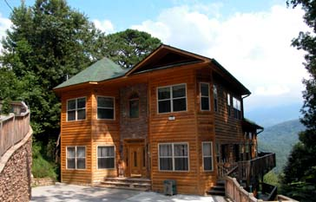
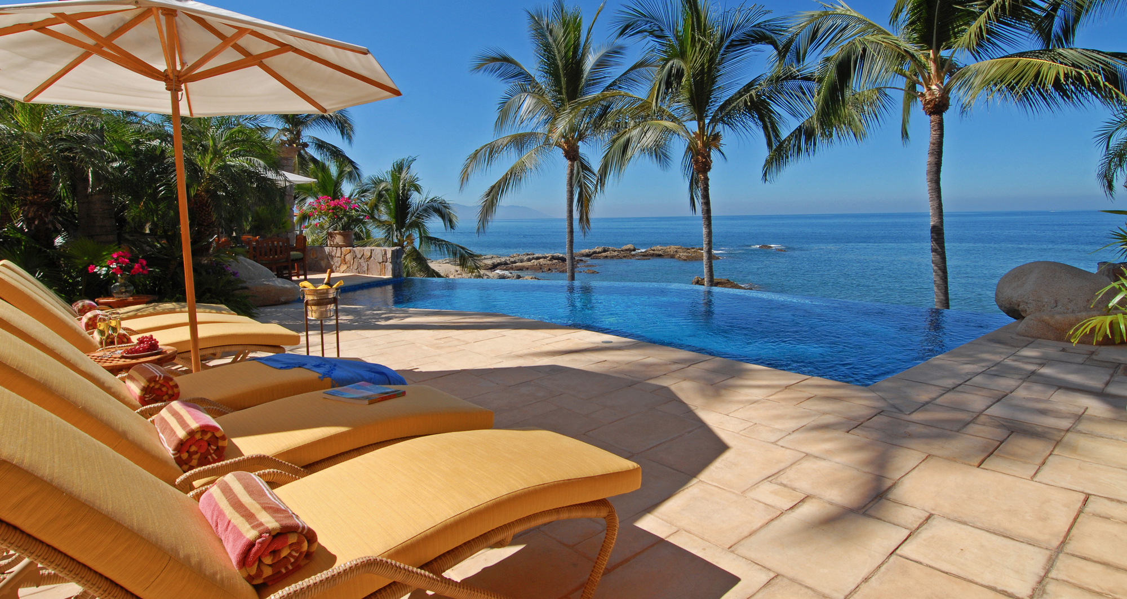

Add pictures of great Family locations in your Vision
Mountain Vacation Home
Summer Vacation Home
3. Family

Slide 7
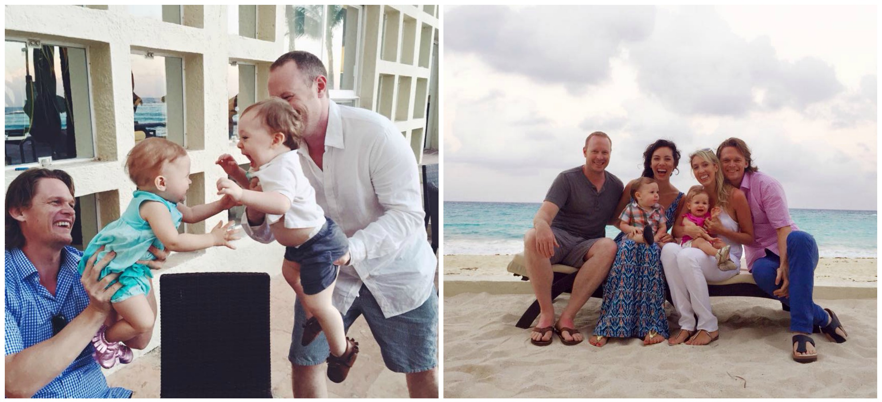
Friends – add your pictures of your friends
4. Friends

Slide 8
Finances – what are your goals?
$____ earned income in 20_ _
$____ passive income in 20_ _
$____ net worth by end of 20_ _
$____ GIVEN AWAY in 20_ _
5. Finances

Slide 9
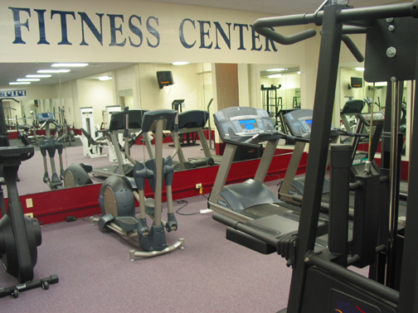
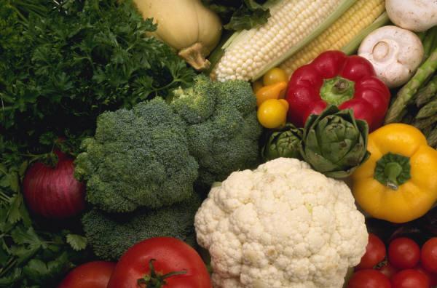
Fitness – how will you improve your health and wellness?
Hit ideal body weight: ___#
Work out __ times per week
Drink 1 gallon of water per day
Nutritional supplements?
Special diets or abstinences (like junk food or alcohol)
6. Fitness

Slide 10
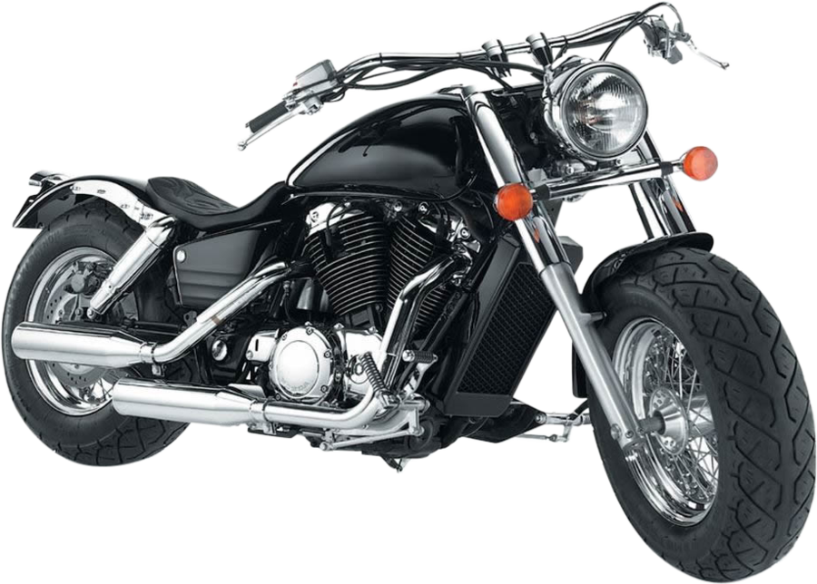
Fun – what will you do to enjoy your success?
These are just example – create your own
Music, video editing suite completed
Harley-Davidson XL 883R Sportster
7. Fun

